Slide 1
Project Name: E-Medicare
Group Number:1
Team Lead: Anjali V Nambrath
Frontend Lead: Akshaya P
Backend Lead: Anvi Tomar

Slide 2
E-Medicare(Group-1)
Created by:
Anjali Nambrath
Aditya Pratap Singh
Akshaya P
Allu Jaswanth
Amit Kumar
Anadasu Tarka Durga Venkatesh
Anuj Singh Saxena
Anurag Kotnala
Anvi Tomar
Atla Krishna Reddy

Slide 3
Overview
What is E-Medicare
E-Medicare Service
Features
Tools and Technologies
Modue Info
Database Schema
Frontend Devlopment
Backend Devlopment
Unit Testing
Benfits
Challenges
Future Scope
Conculsion

Slide 4
What E-Medicare???
It’s a full stack responsive and dynamic web-application.
Used for Ordering Online medicines.

Slide 5
E-Medicare Service
Medicare is a company and E-Medicare is Our Web-Application that supplies medicines and a couple of other healthcare essentials products at an affordable price.

Slide 6
Features
Easy to access
Add to Cart
Payment Gateway
Security

Slide 7
Tools and Technologies:
Front-End: Angular Framework
Server-side: Spring Boot.
Back-end: MYSQL, JPA
Server: Tomcat

Slide 8
Module Info
Login/SignUp Module.
Admin Module.
User Module.
Add to Cart, Payment Process, Order Summary Modules.

Slide 9
Database Schema
Addto Cart cartid(int)-PK email(String) medname(string) price(float) medid(int)
Medicine medid(int)-PK medname(String) price(float) seller(string) description(string) medimg(string) category(string)
Account name(String) mobile(int) email(string)-PK password(string) typeofuser(string

Slide 10
Login/SignUp Module(Functionalities)
SignIn
SignUp
Update Password
Update Profile of a User
View Profile of user

Slide 11
Cont.(Backend)
Entity Class-
Used to create a table
Controller Class
Used for processing incoming REST API requests.
Service Class
The business logic of all the functionalities resides there
JPA Repository

Slide 12
Cont.(Frontend)
Created Component
HTML,CSS and TS File
Parent Component
Routing and Linking
Created Service Class

Slide 13
Admin Module(Functionalities)
User can view all the medicines available.
Admin can add.
Add can update, delete, view all etc.

Slide 14
Admin Operation
Perfom CRUD operation
Data-Oriented and Standardise
Use of http action verbs:
(i)Get
(ii)Put
(iii)Post
(iv)Delete

Slide 15
User Module(Functionalities)
User can view all the medicines available.
User can view the medicines category-wise.
User can also search for a specific medicine.

Slide 16
Cont.(Backend)
Entity Class
Medicine.java
Controller Class
MedicineController.java
Service Class
MedicineService.java
Repository Class
MedicineRepository.java

Slide 17
Add to Cart, Payment Process, Order Summary Modules(Main Functions)
Add to Cart
Remove From the Cart
Order Summary
Generate total bill amount
Delete the cart after payment

Slide 18
Unit Testing
Perfom JUnit Testing.
AccountServiceTest
MedicineServiceTest
CartServiceTest
Perfom Functional Testing.
Use Eclipse ide for testing.

Slide 19
Benfits of E-Medicare in Health Domain
Improve Communcation among healthcare and stakeholders.
Supports better decision.
Reduce Medical Errors.
Enhance reporting capabilities.
Encourage disease Prevention and wellness.

Slide 20
E-Medicare Challenges
Information
Human Resources
Infrastructure
Quality and Security of Data
Financial and legal issues
Authenticity

Slide 21
Future Scopes
Online Training.
Govt and Private Sector.
Good flow of information
Funding and Public Support
Advancement of technologies
Linking with small medical shops of small city and village

Slide 22
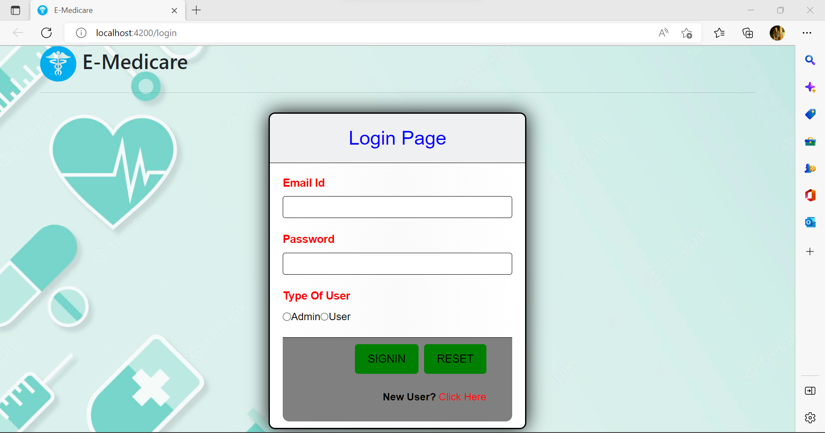
Screenshots

Slide 23
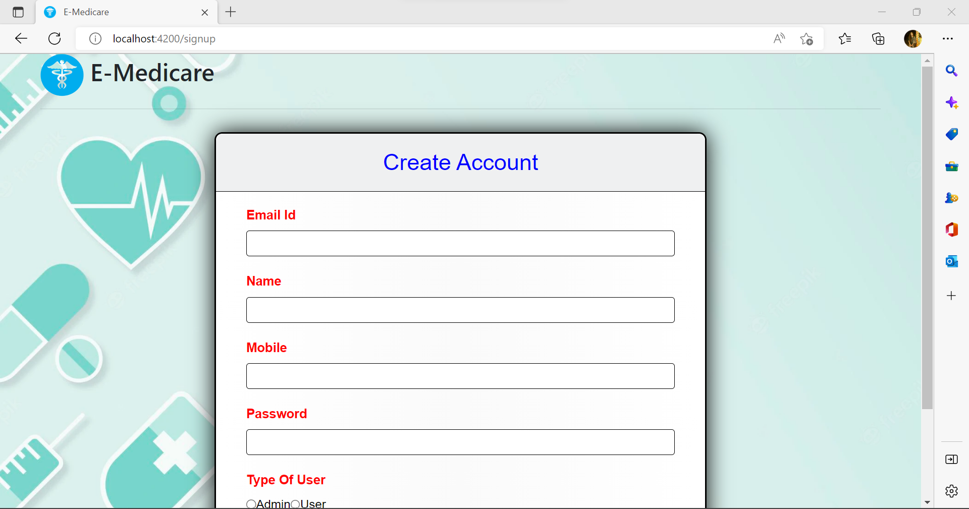

Slide 24
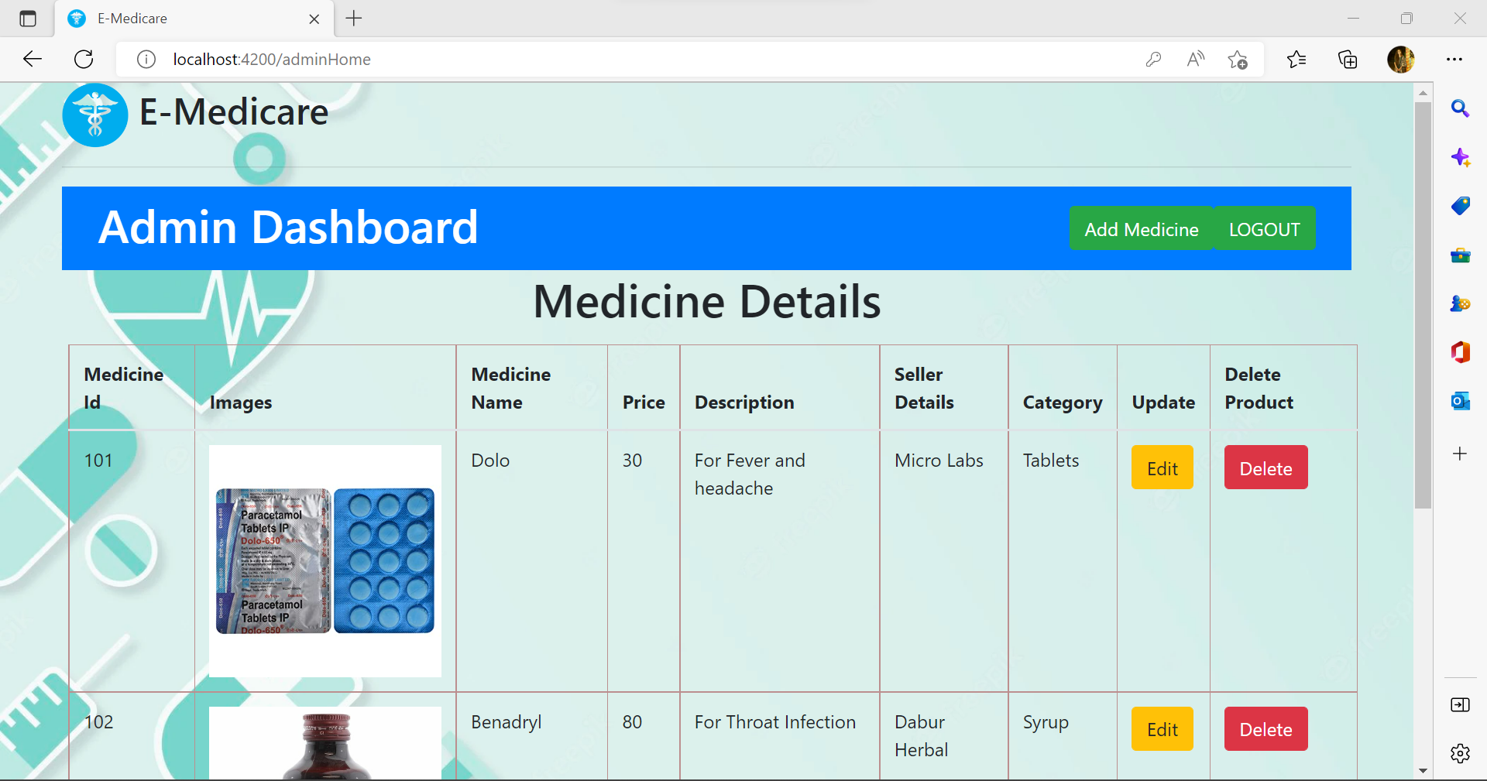

Slide 25
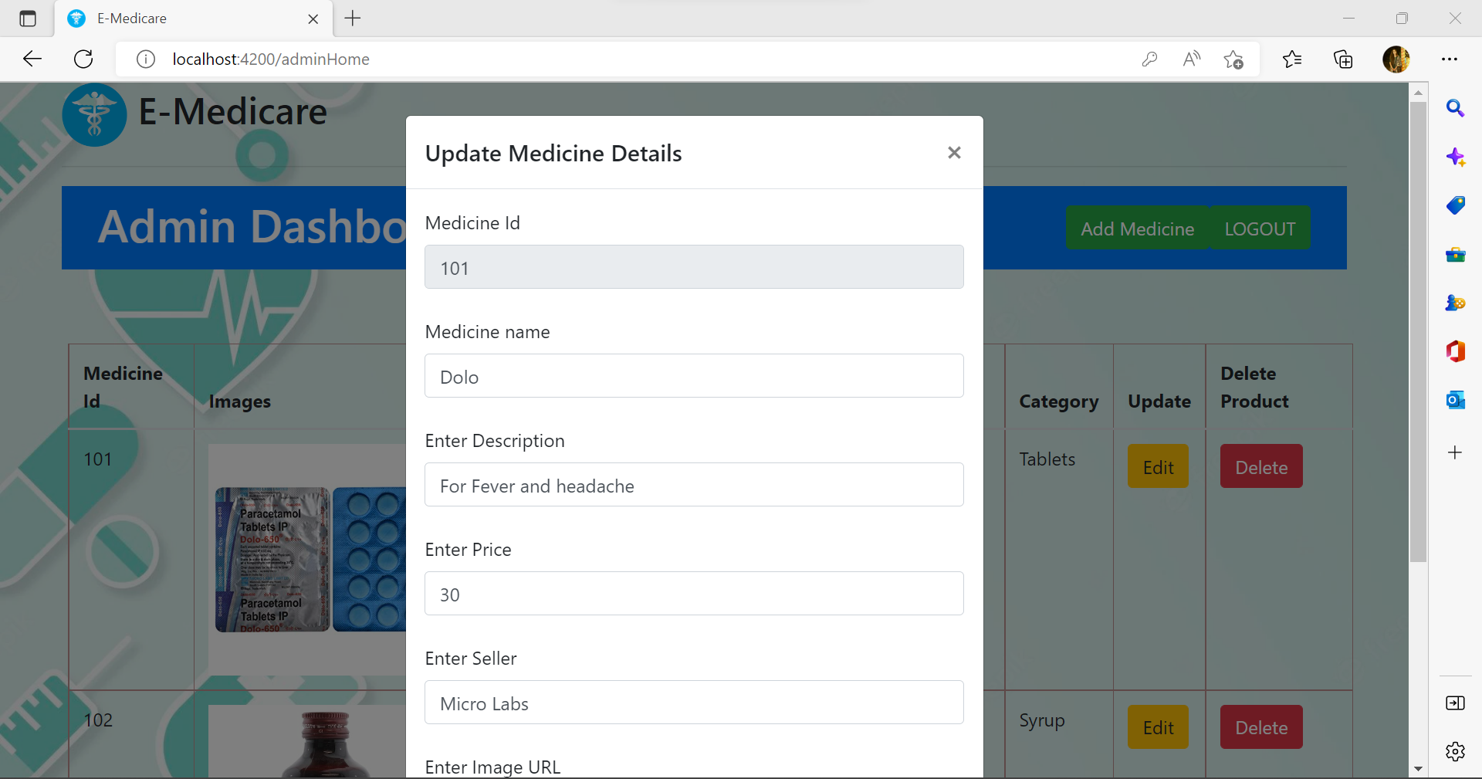

Slide 26
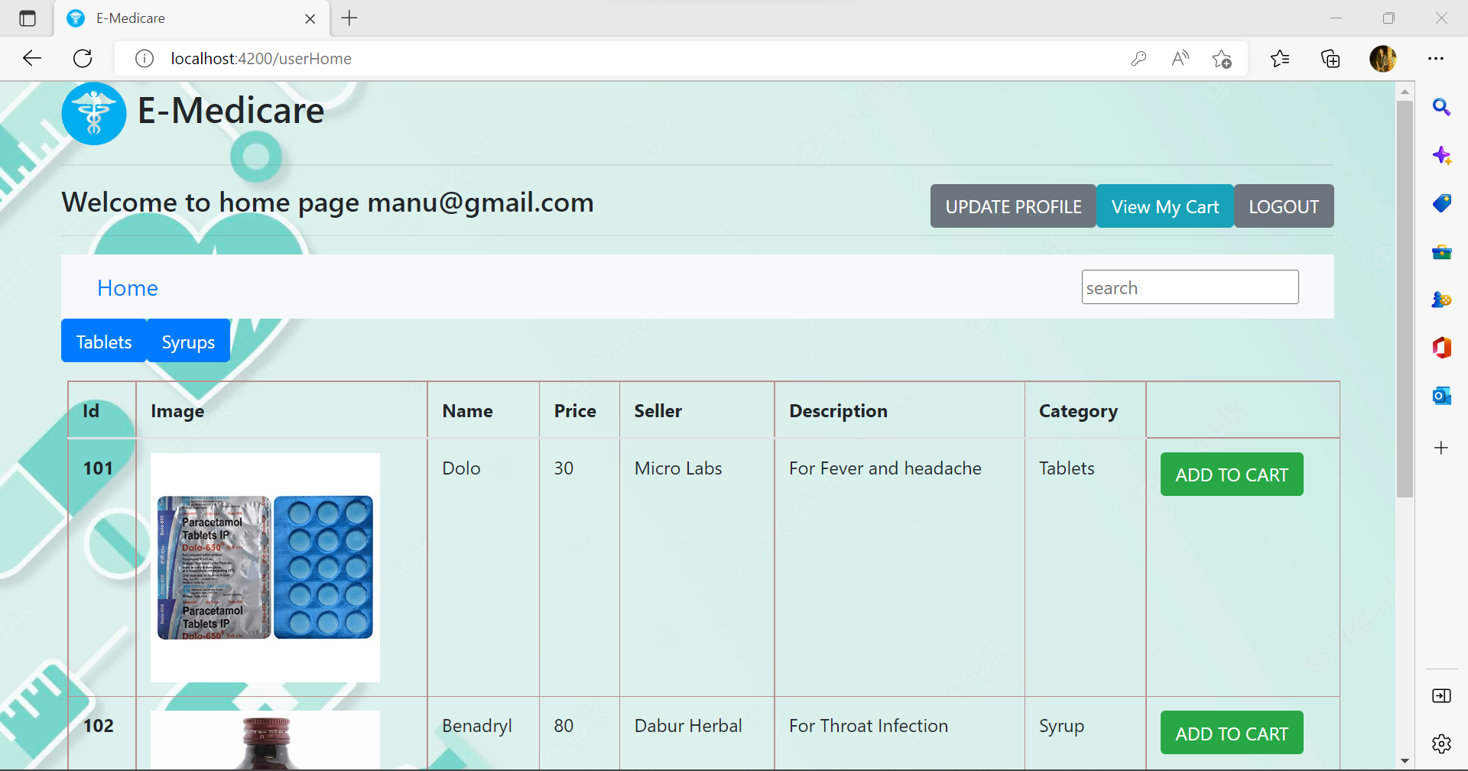

Slide 27
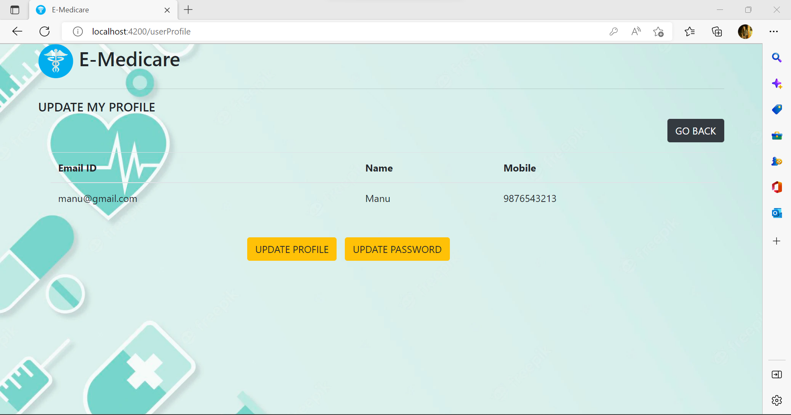

Slide 28
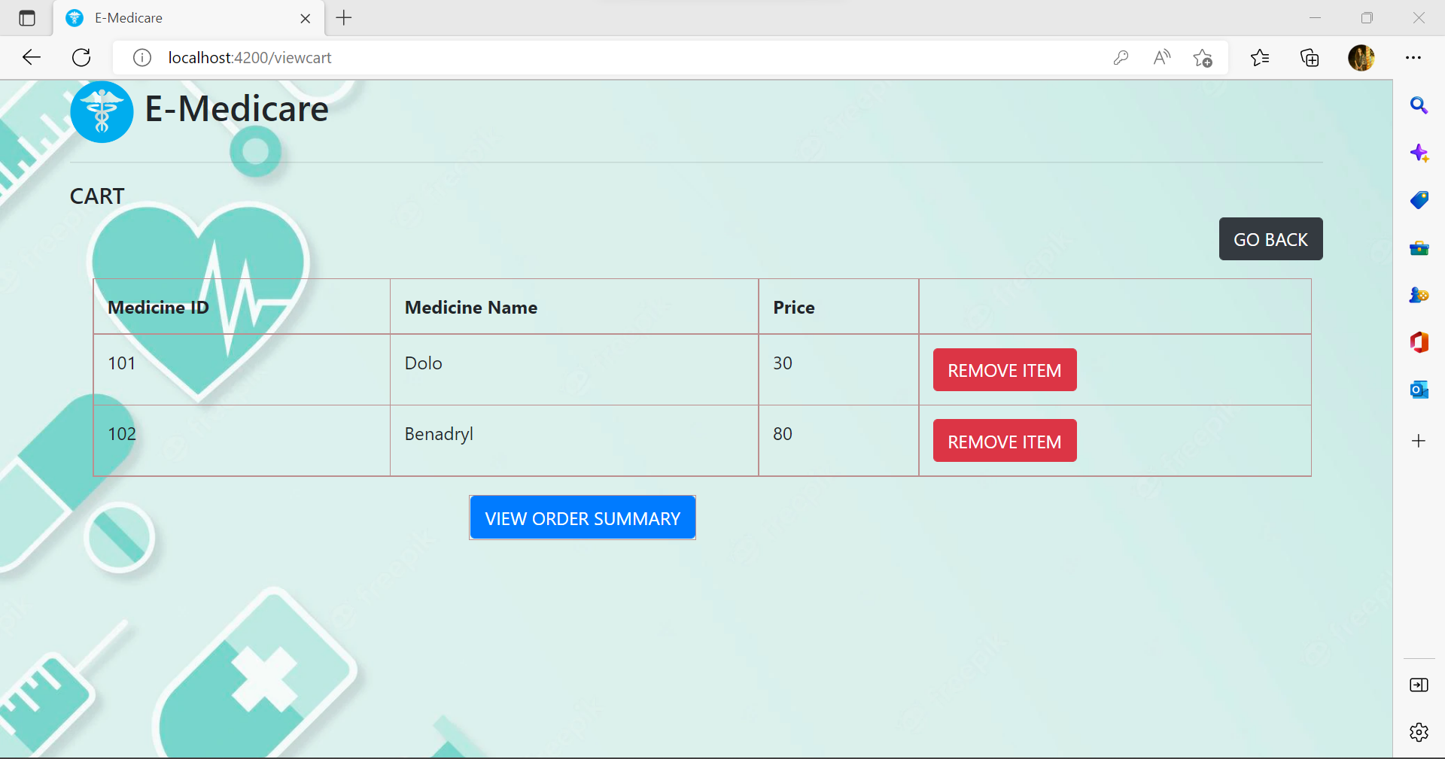

Slide 29
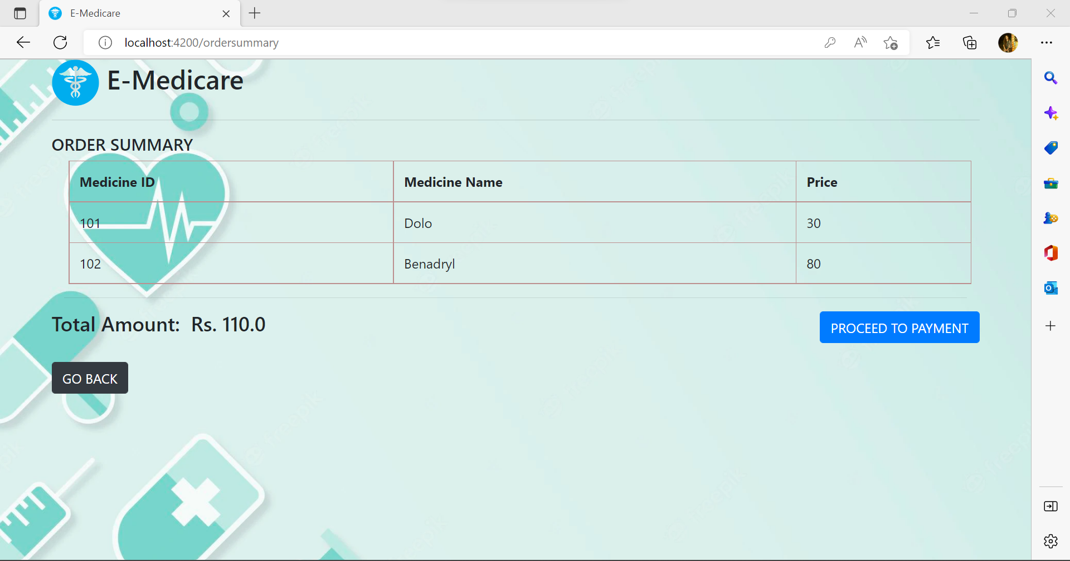

Slide 30
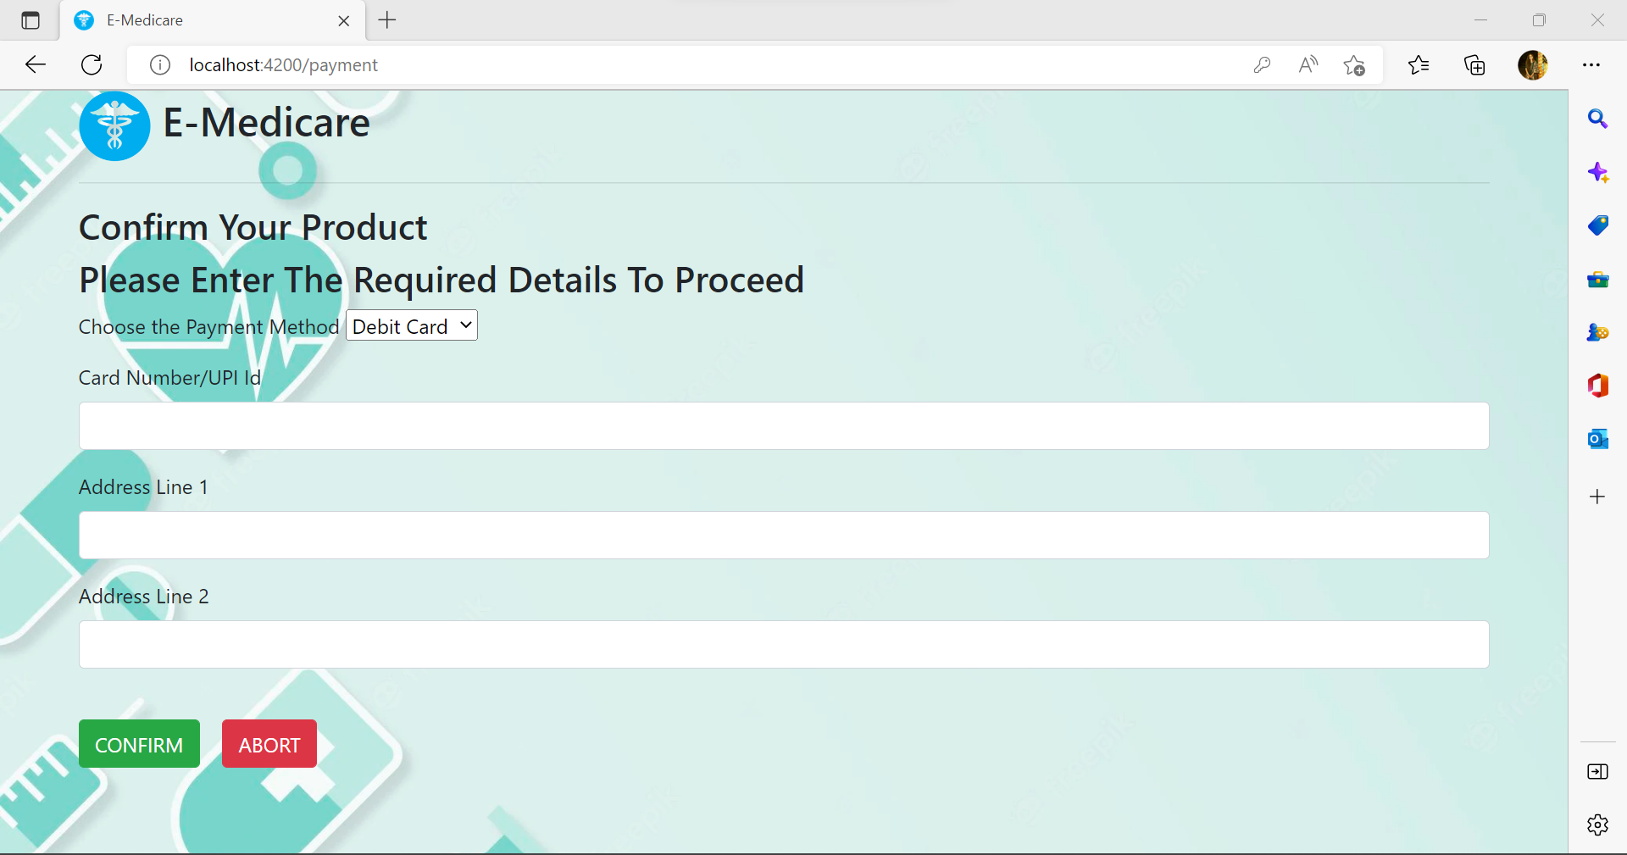

Slide 31
Conclusion
At the end we developed a full web application for our healthcare domain with a rich and user-friendly interface. So that our user can easily interact and understand with our UI.

Slide 32
Thank You!

